Slide 1
Fitzpatrick Thresholding for Skin Image Segmentation
Lia Gracey, MD, PhD
Director of Teledermatology and Digital Health Strategy, Ascension Texas
Assistant Professor of Medicine, Division of Dermatology
University of Texas at Austin - Dell Medical School
lia.gracey@austin.utexas.edu
Duncan Stothers, AB
Machine Learning Researcher (independent)
duncanstothers@alumni.harvard.edu

Slide 2
Disclosures
Lia Gracey, MD, PhD
Member, Image Collection Work Group, American Academy of Dermatology (Honoraria)
Member, Teledermatology Committee, American Academy of Dermatology
Chair, Annual Awards Committee, Women’s Dermatologic Society
Robert A. Winn Excellence in Clinical Trials Career Development Award (Grant)
Duncan Stothers, AB - Computer Science (Honors)
Google Health – Machine Learning Software Engineer
Google Tensor SoC – Machine Learning Software Engineer
Mary Gordon Roberts Research Fellowship at Harvard University (Grant)
Founder, Frontier Medical AI Foundation
Notes:
Challenges with assessing psoriasis severity
Skin of color
Methodological approach
Results
Future directions
The only relevant ones are that I am a member of the Image…which aims to collect more representative photographs of skin conditions in all skin tones to be used in lectures, such as this
The overwhelming majority of educational materials show skin conditions in lighter skin tones

Slide 3
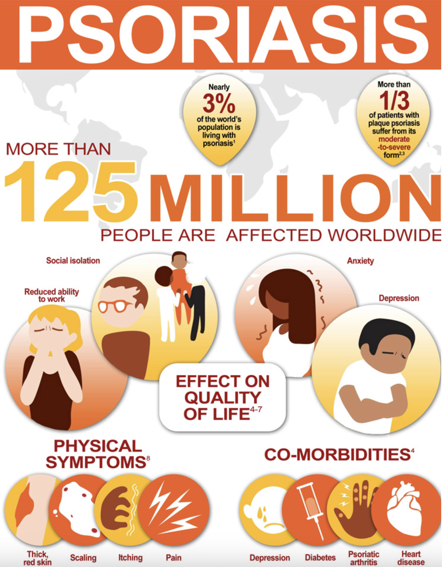
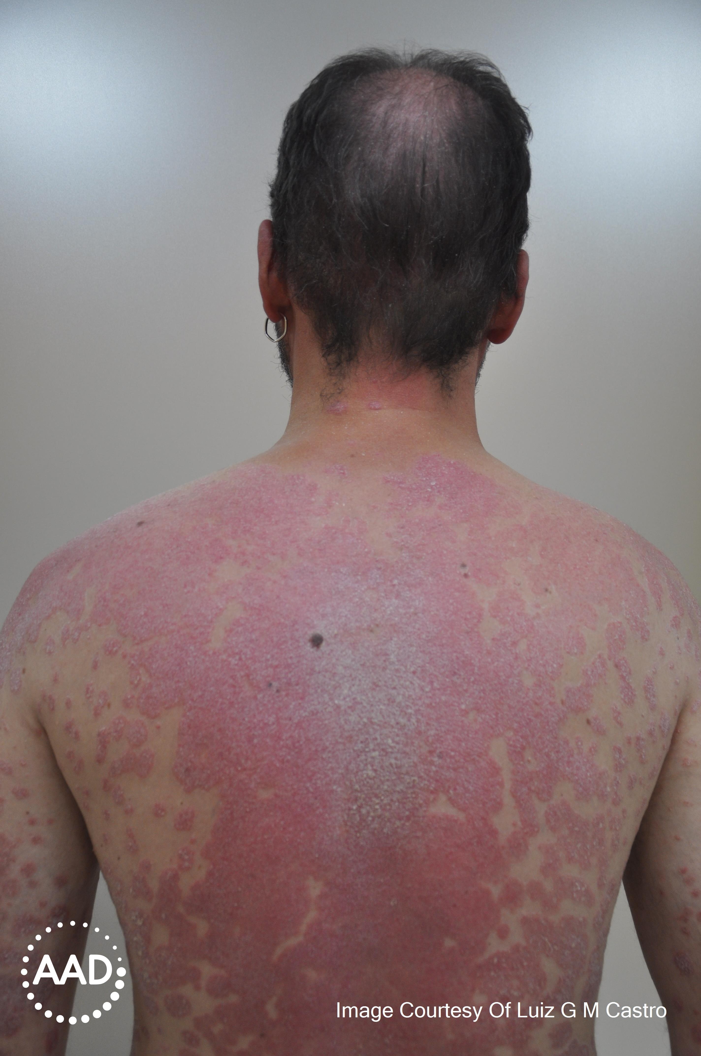
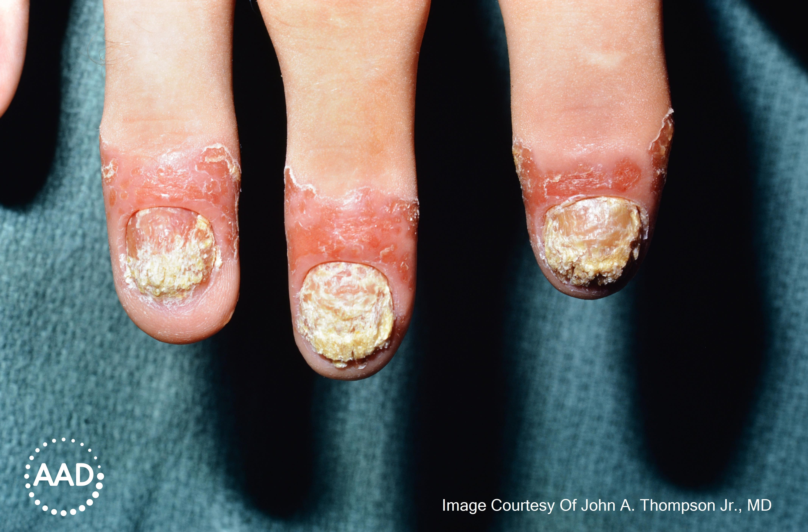
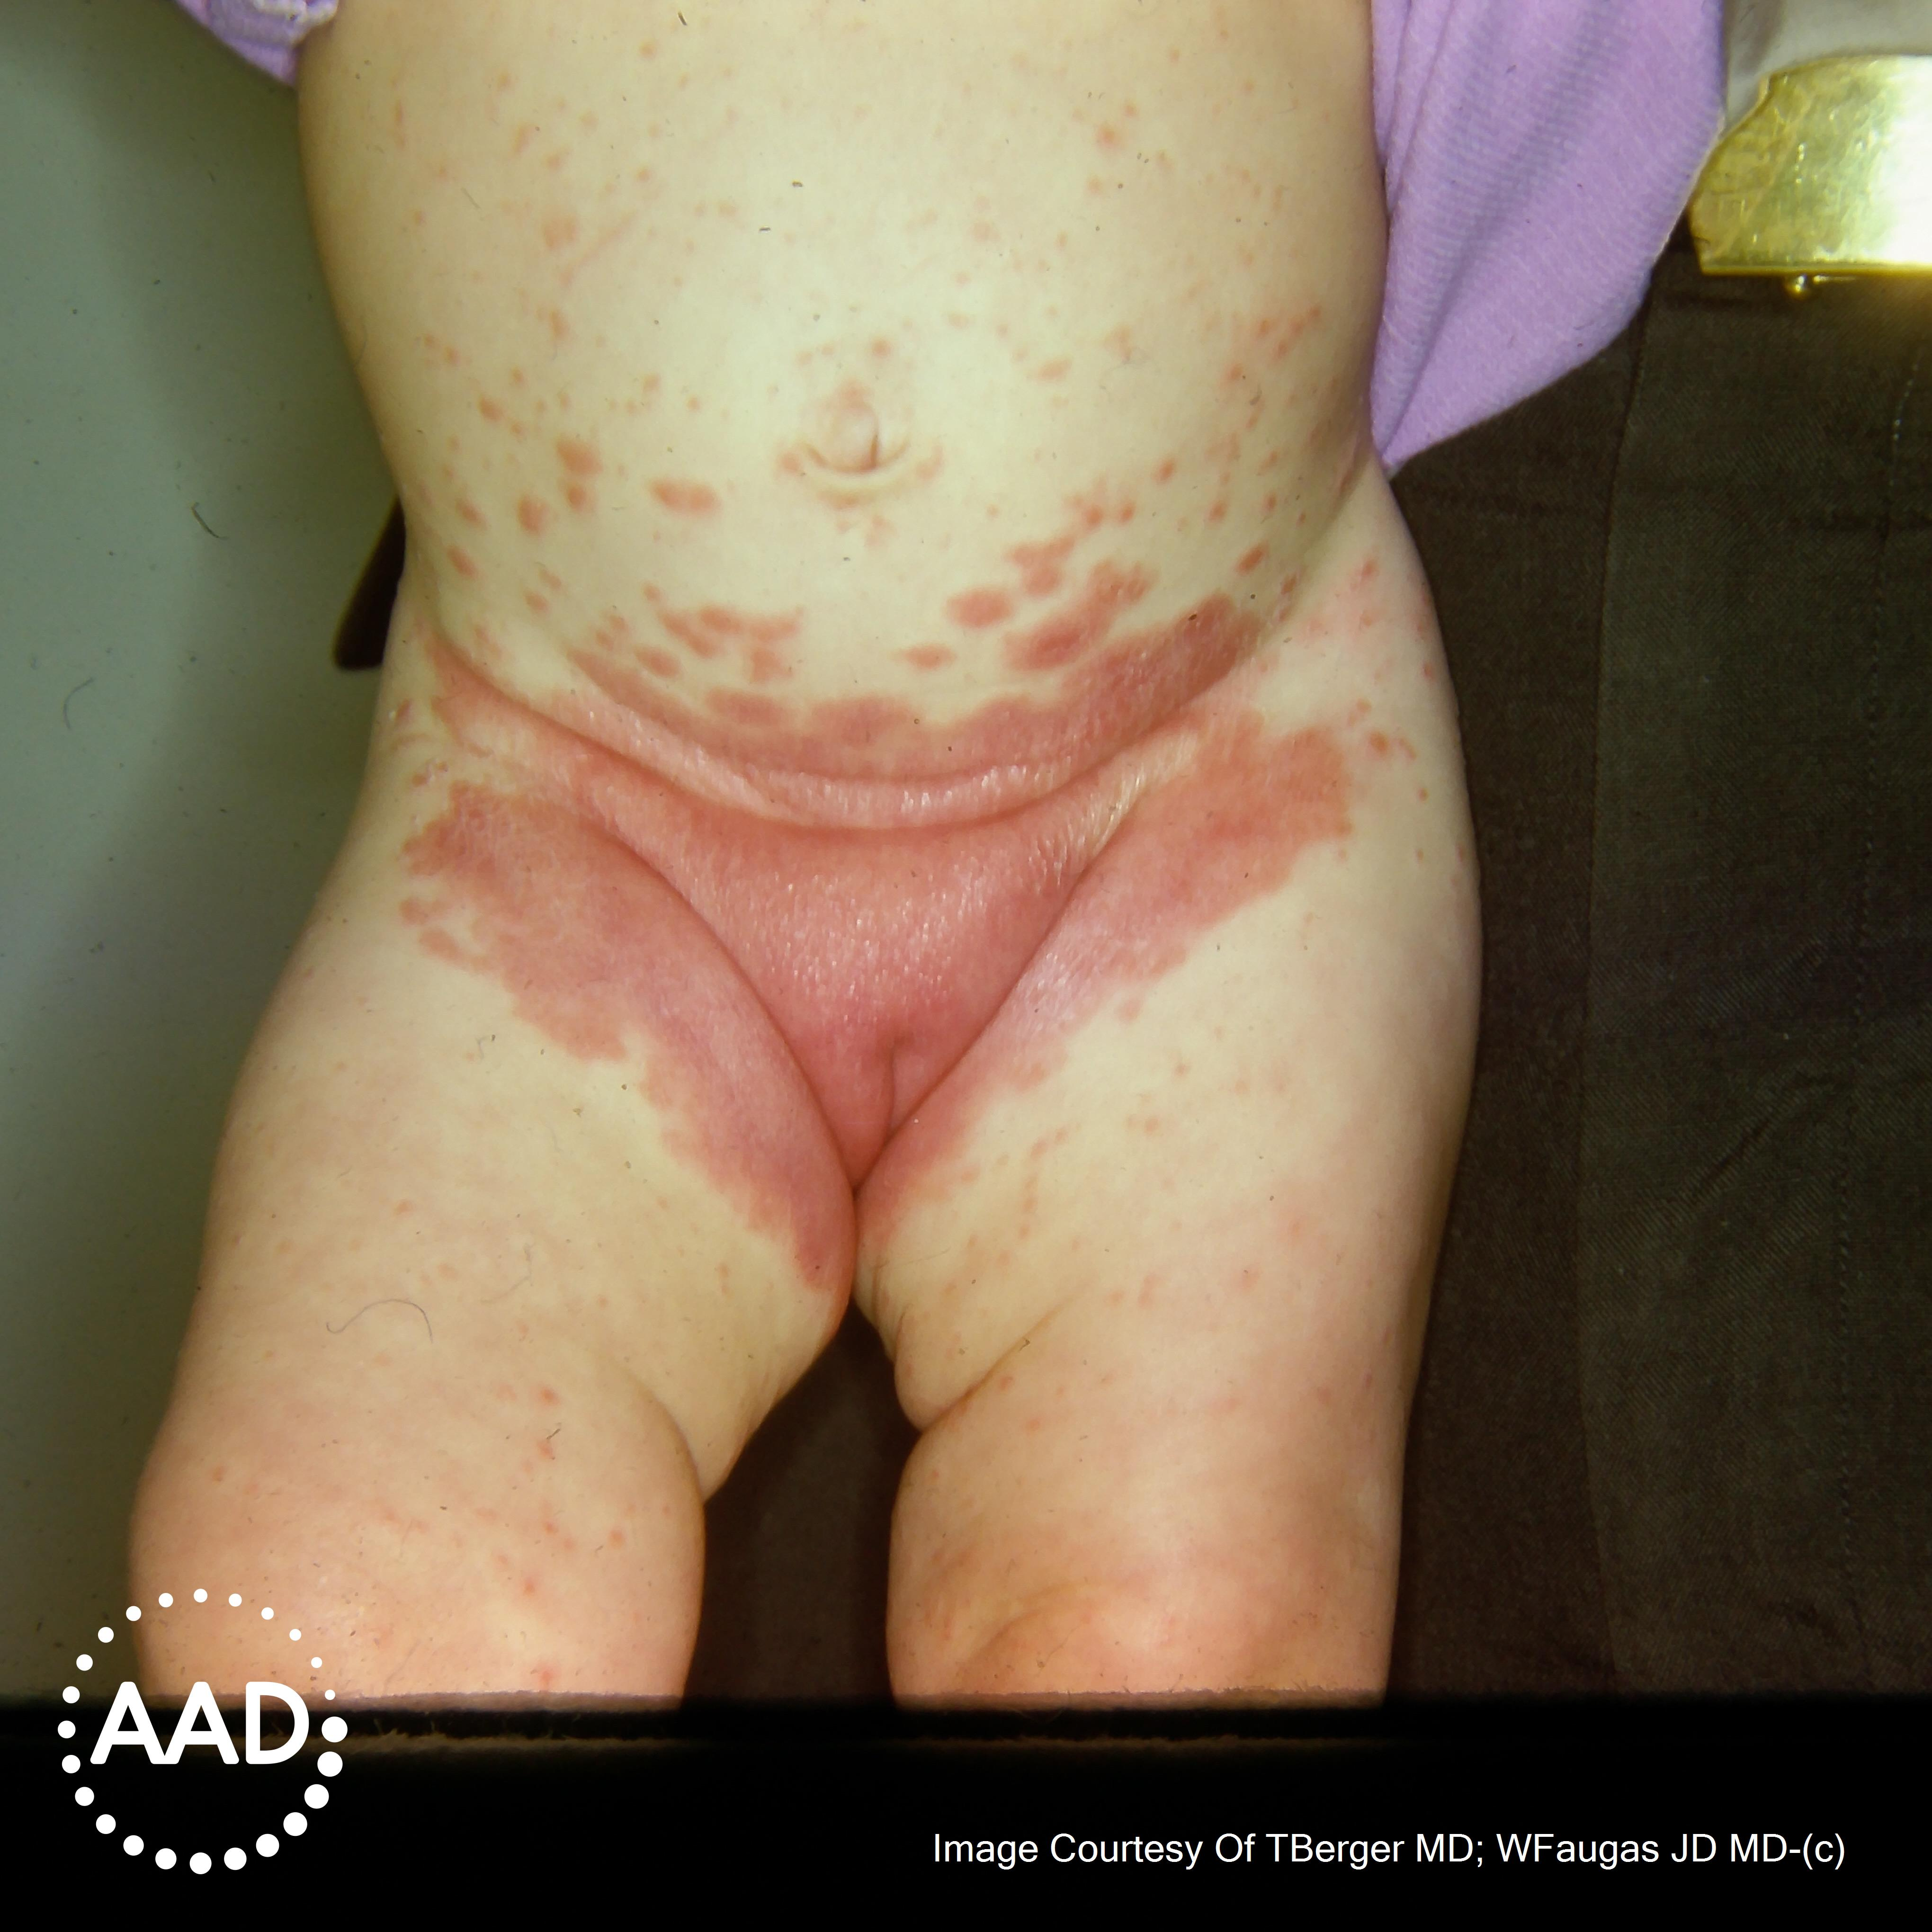
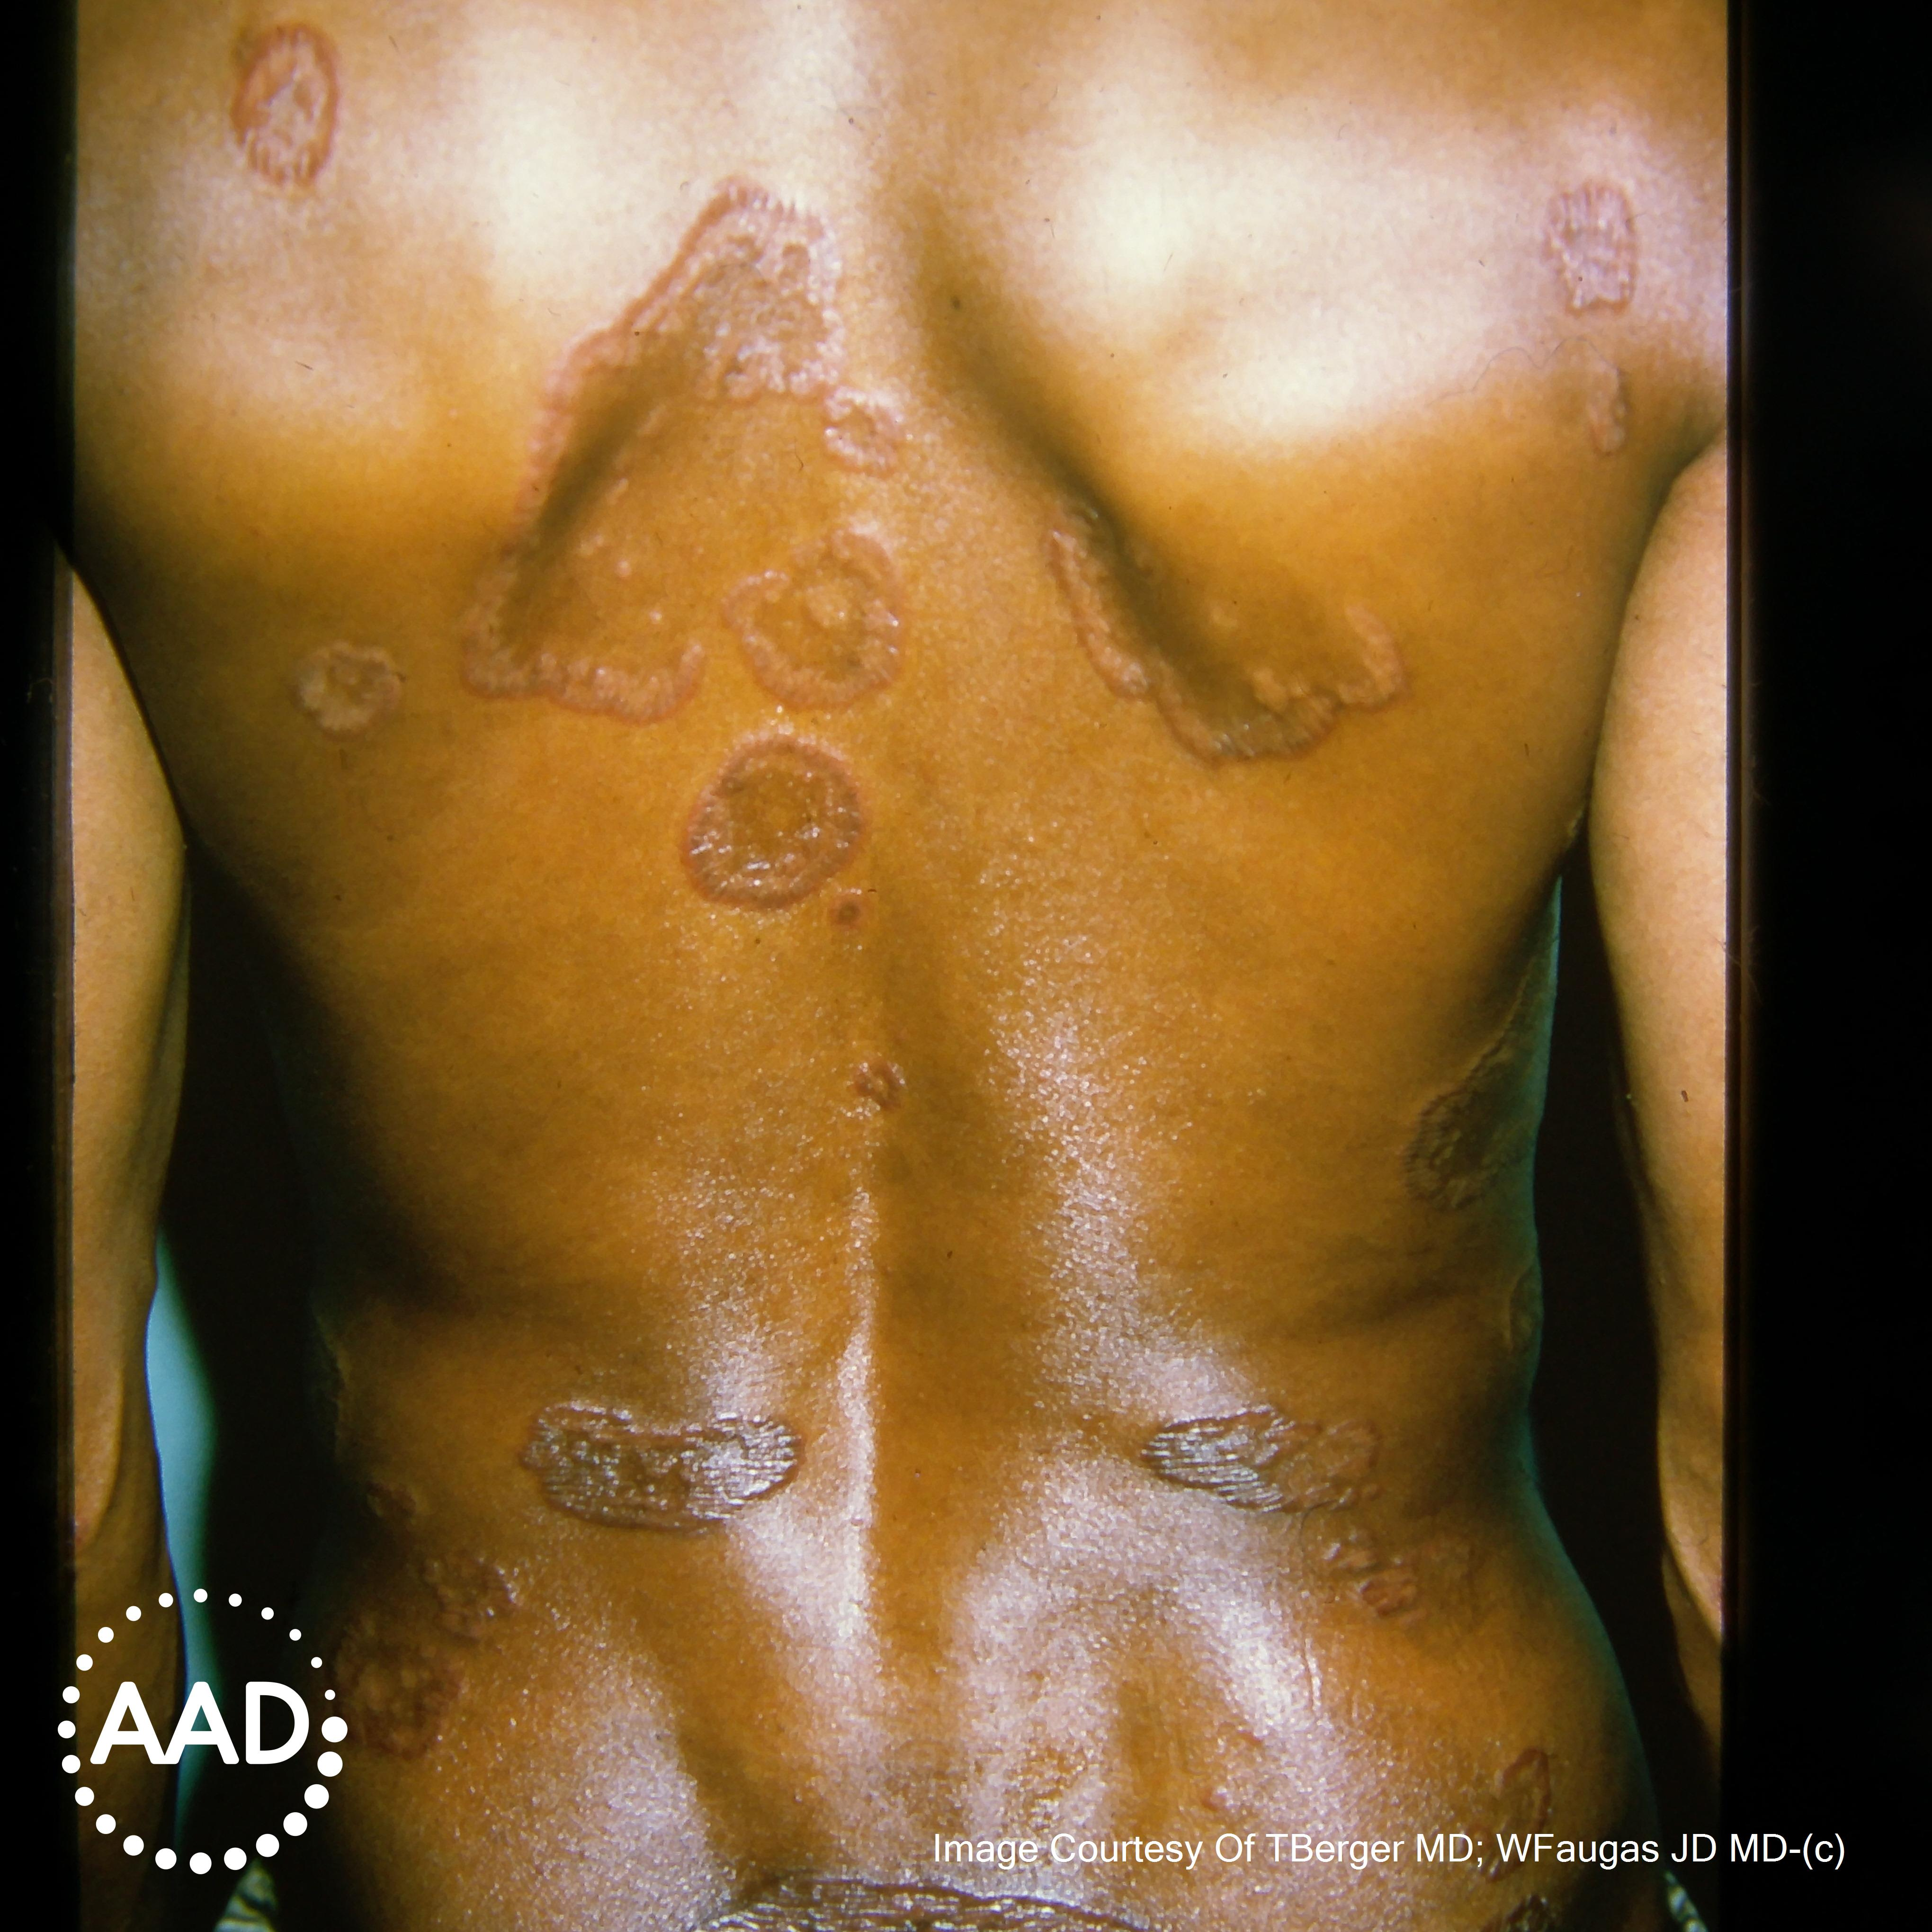
Novartis
Notes:
I know this is more of a computational conference, but I wanted to spend some time clearly laying out the clinical problem. Psoriasis is a common and extremely impactful chronic inflammatory disease with a variable presentation
Well-defined red erythematous plaques with silvery scale in lighter skin tones, absence of scale when involving skin folds, can affect joints and fingernails, and have a lack of redness and blurring of the borders in darker skin tones
Impact of quality of life of psoriasis
Serves as a good model system

Slide 4
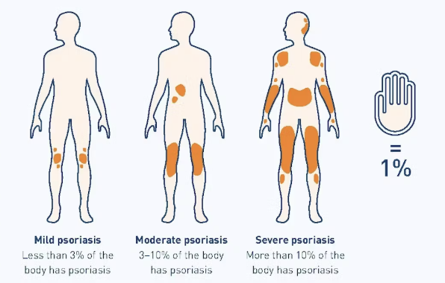
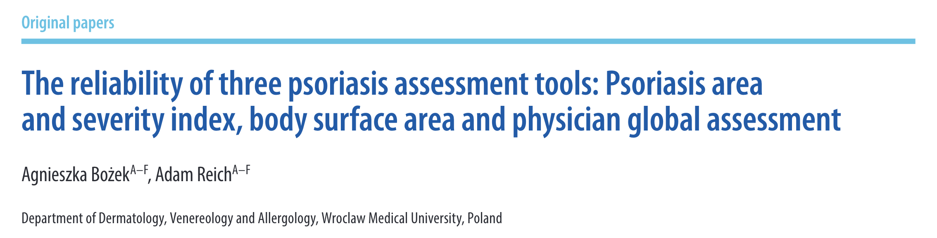
Body surface area
National Psoriasis Foundation
Notes:
When I was mentioning the severity of psoriasis, there are multiple metrics for how to assess
Clinical relevance – this is what I’m calculating in my head in clinic when deciding initial treatment approaches, this is what I document in my notes, I know insurers are looking for at least 10% body surface area
Clinical trials implication – there will be multiple metrics used in an artificial trial setting, inaccurate metrics
We have seen in multiple studies that there is great variability between raters for these metrics, including body surface area, and the psoriasis area and severity index (or PASI) score of which body surface area is a factor

Slide 5
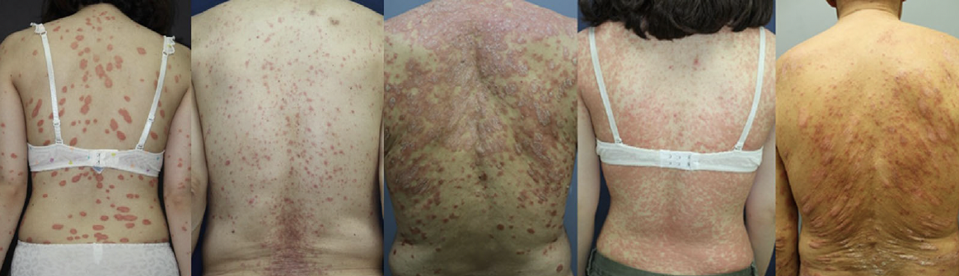
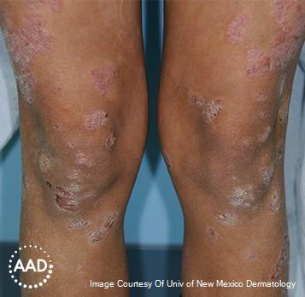
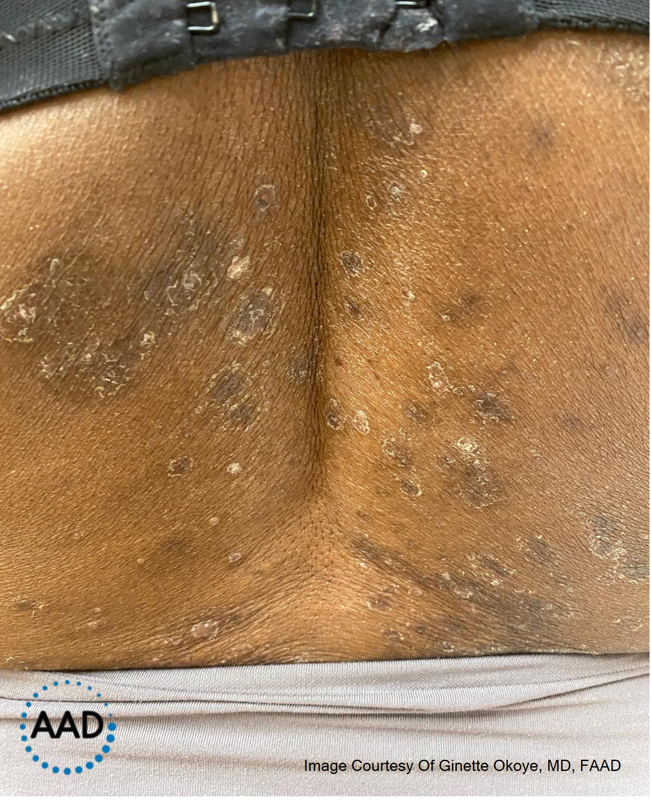
Body surface area estimation error
Yoo KH, Jeong GJ, Park JH, Park SH, Li K sok. Estimation error of the body surface area in psoriasis: a comparative study of physician and computer-assisted image analysis (ImageJ). Clin Exp Dermatol. 2022;47(7):1298-1306. doi:10.1111/ced.15148
Notes:
And you can see why here to have the brain accurately piece together these discontinuous plaques when there is a high percentage of involvement is a challenge
Laid out nicely by this figure from Yoo et al, this work was largely done in lighter skin tones

Slide 6
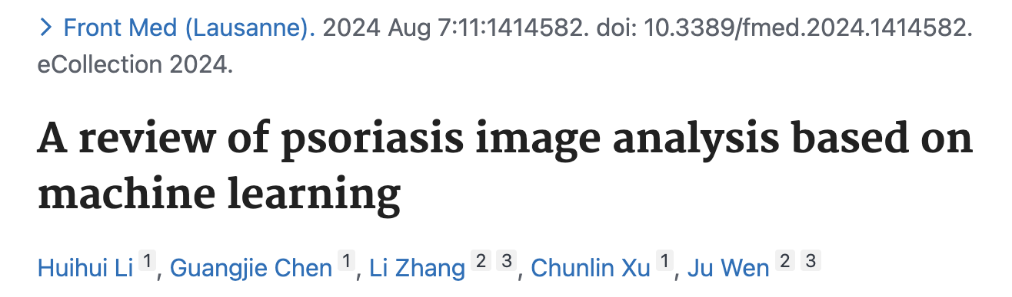
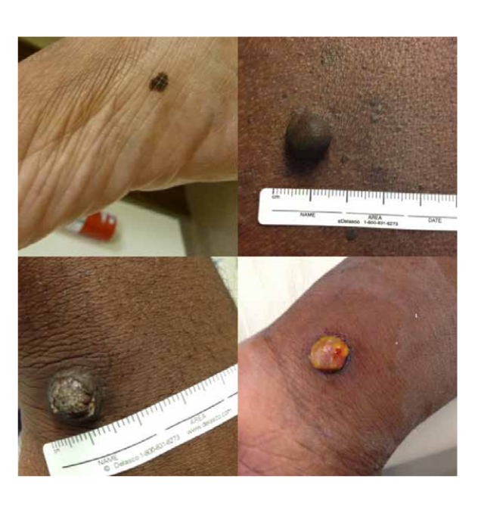
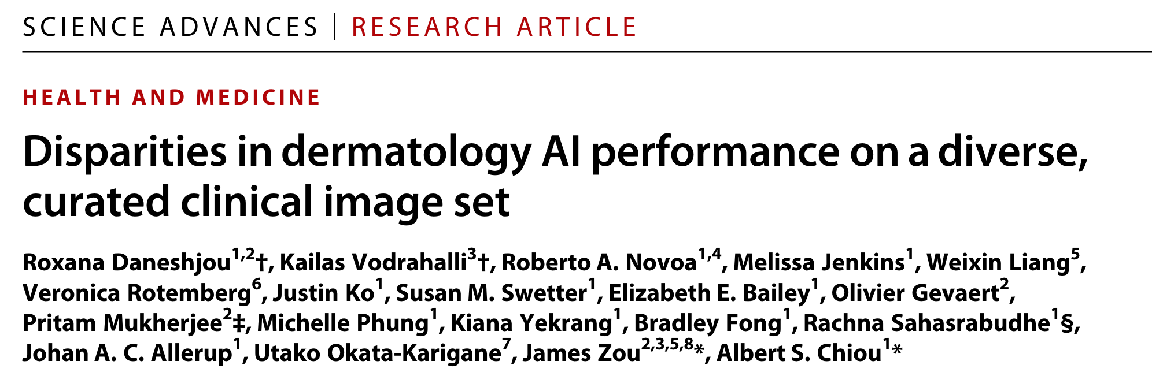
Prior work
Notes:
There has been some great work already done by people in this room for machine learning for psoriasis images, including for body surface area and PASI scores
I do want to make sure we don’t anchor ourselves in skin tone representation the same way that clinical trials and even machine learning for skin cancers have done
Tremendous work in prior ISIC challenges to curate photos
Prior skin lesion literature – gold standard diagnosis algorithms fail at identifying lesions in darker skin tones

Slide 7
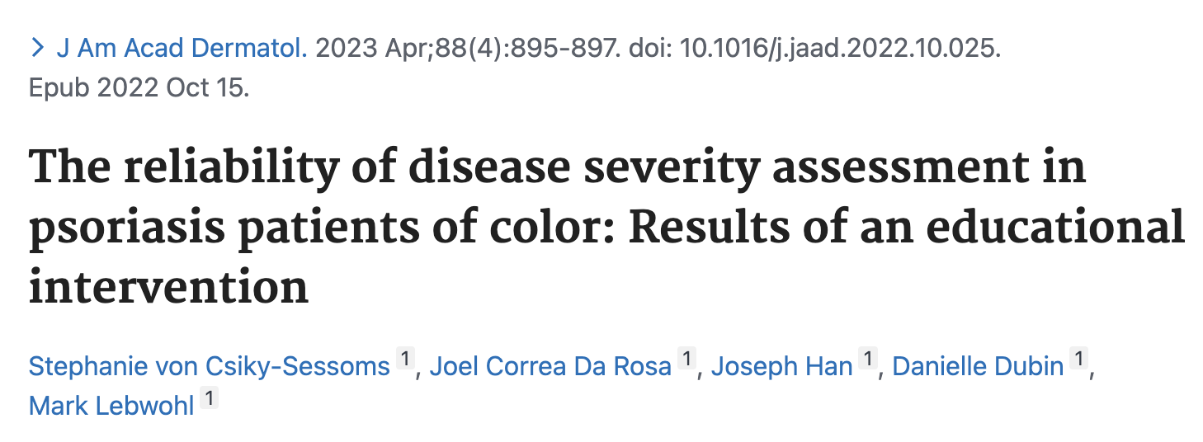
Variability assessing psoriasis in skin of color
Notes:
We see this in psoriasis as well
Small study, board certified dermatologists and trainees calculate PASI scores from photos of psoriasis in different skin tones, found great variability between raters
Educational program – teach how to handle erythema

Slide 8
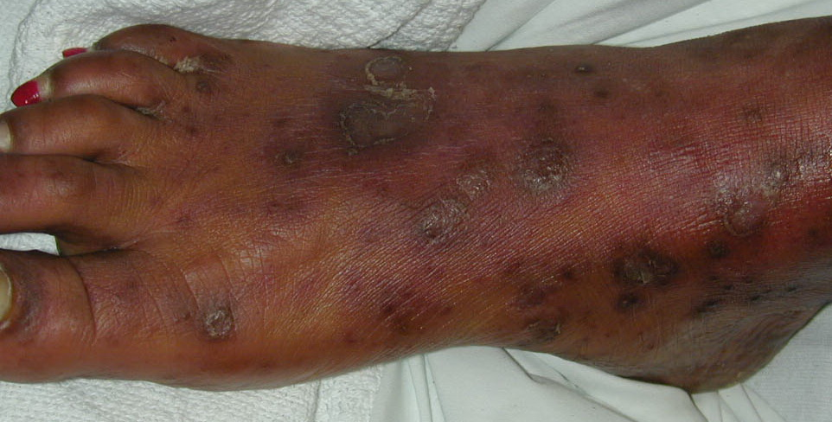
Subjectivity
Where does psoriasis start and end? What is active vs post-inflammatory change? How to manage subtypes of psoriasis?
Notes:
Psoriasis and other rashes provide a challenge for labeling compared to skin cancers
Consensus on what is active psoriasis – some interesting work on algorithms that learn how different people label data
How do we manage subtypes of psoriasis – nails, scalp

Slide 9


Methodology
Fitzpatrick 17k de-duplicated
(Hybrid)
Hellenic
(Greece)
DermAtlas.net
(USA)
Back and forth with MD PhD Dermatologist specializing in inflammatory skin diseases until the labels are extremely precise
DermNetNZ
(New Zealand)
Dermatology Trainees provide initial segmentation masks
DermIS
(Germany)
Psoriasis Images (Unlabeled)
Filtered Psoriasis Images
(Unlabeled)
Filtered Psoriasis Images
+ Fitz labels
Filtered Psoriasis
Images
+ Fitz labels + Segmentation Masks
Atlas Dermatologico (Brazil)
Deduplicate, &
Board-certified dermatologist removes misclassified images
Excl. Nail psoriasis, Pustular psoriasis
Dermatologist manually adds Fitz label for every image
Filter out images where Fitz label isn't feasible
Train a cross section of common segmentation architectures on the data
Using common / vanilla optimizer strategies and data-augmentation
On the validation set, compute the global optimum operating points for Dice and bIoU
As well as the Fitz-stratified optimum operating points for Dice and bIoU
On the test set
Compare the performance of Fitz-stratified operating points to using the simple global optimum operating point
(For both Dice and bIoU)
U-Net (all-conv)
Ronnenberger 2015
ResU-Net (all-conv + residuals)
Zhang 2018
SETR (mostly attention)
Zheng 2021
Notes:
Pustular and nail are considered separate entities where BSA isn’t clinically relevant

Slide 10
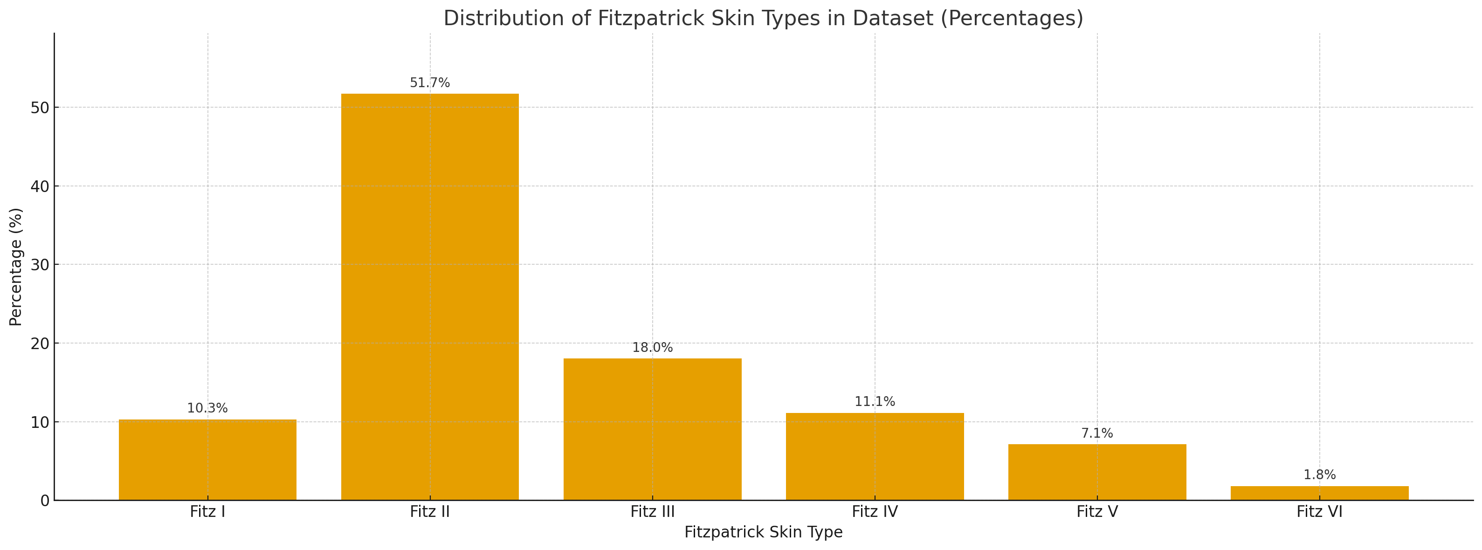
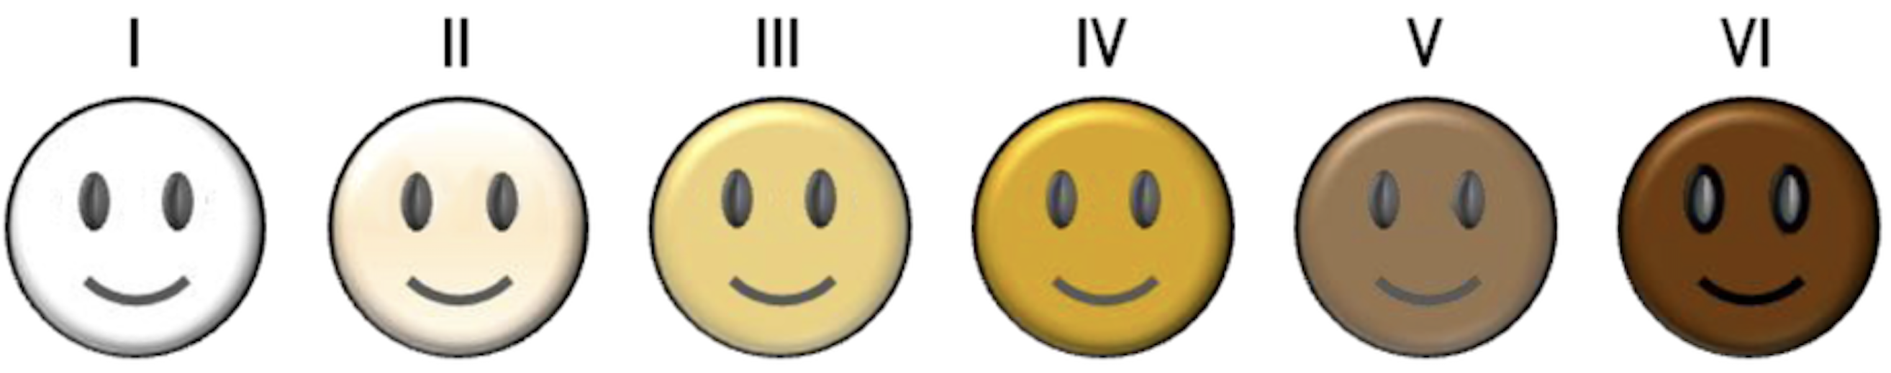
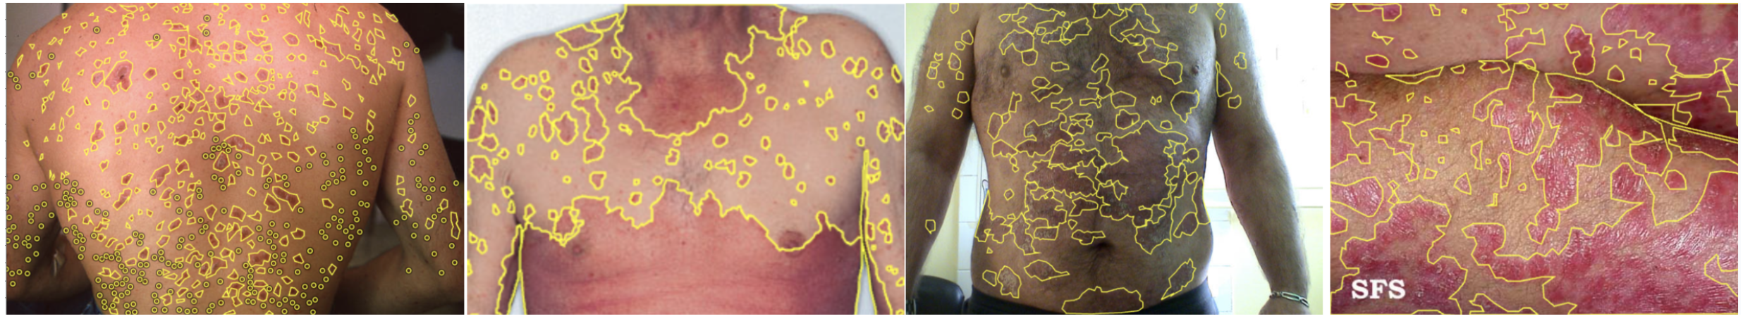
Approach
Highly information dense, extremely precise labelling by qualified professionals to help compensate for low dataset size (~1000 images)

Slide 11
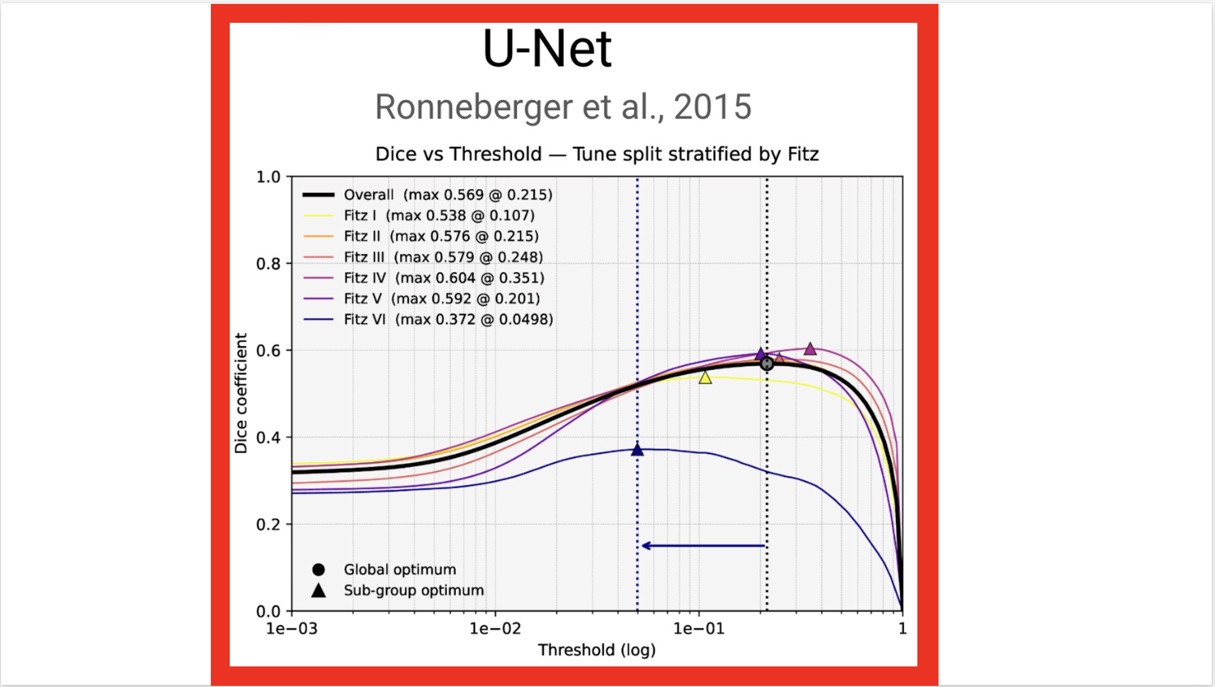
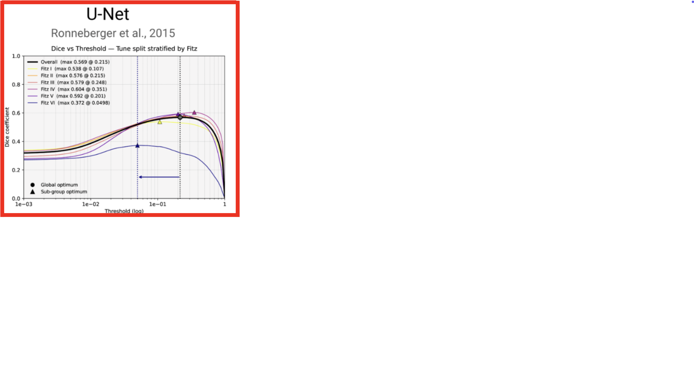
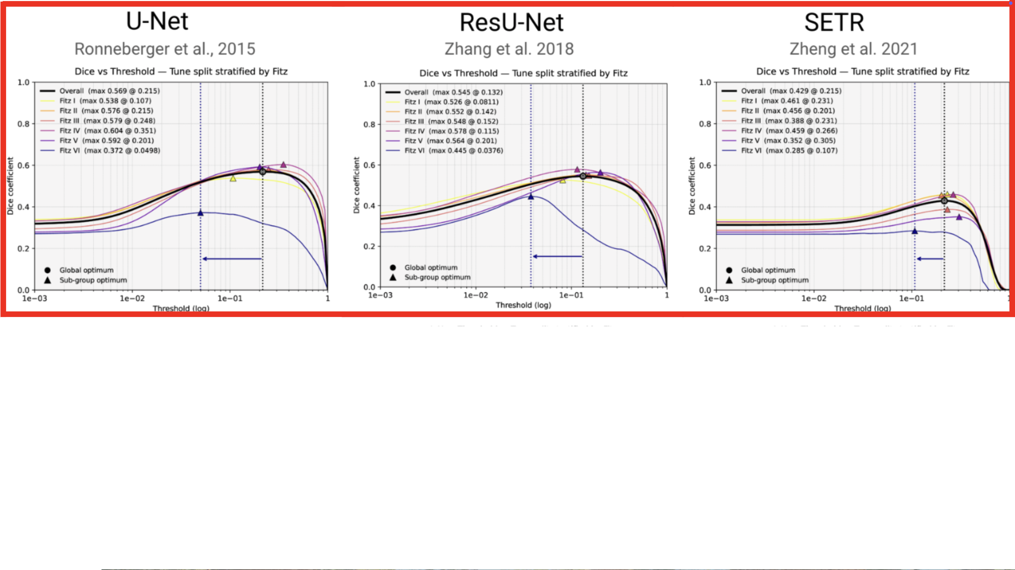
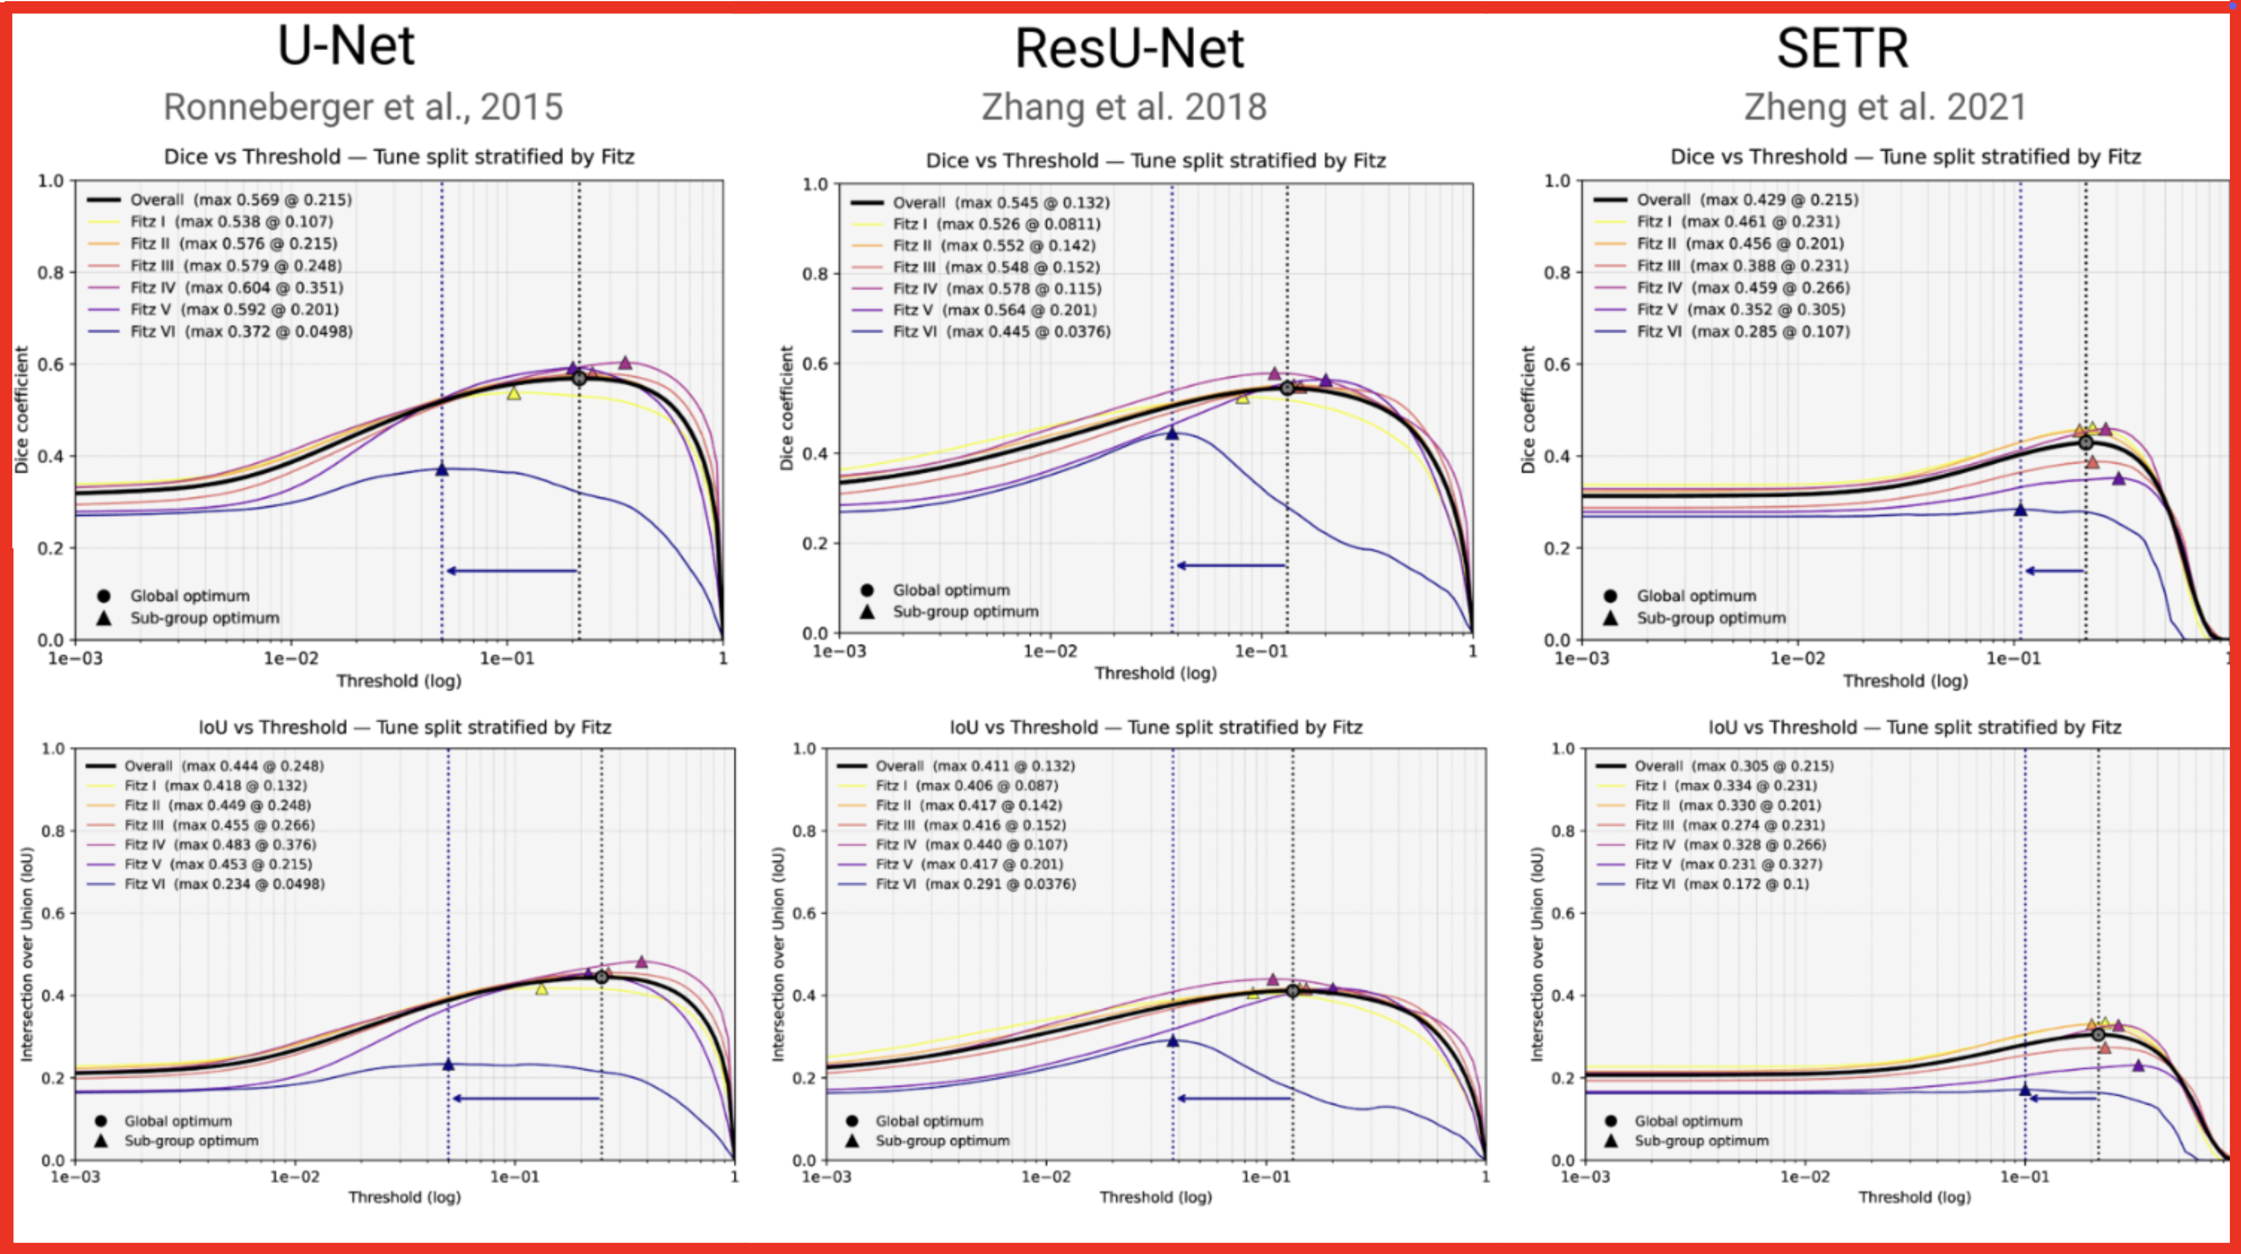
Notes:
Animation – zoomed in top left

Slide 12
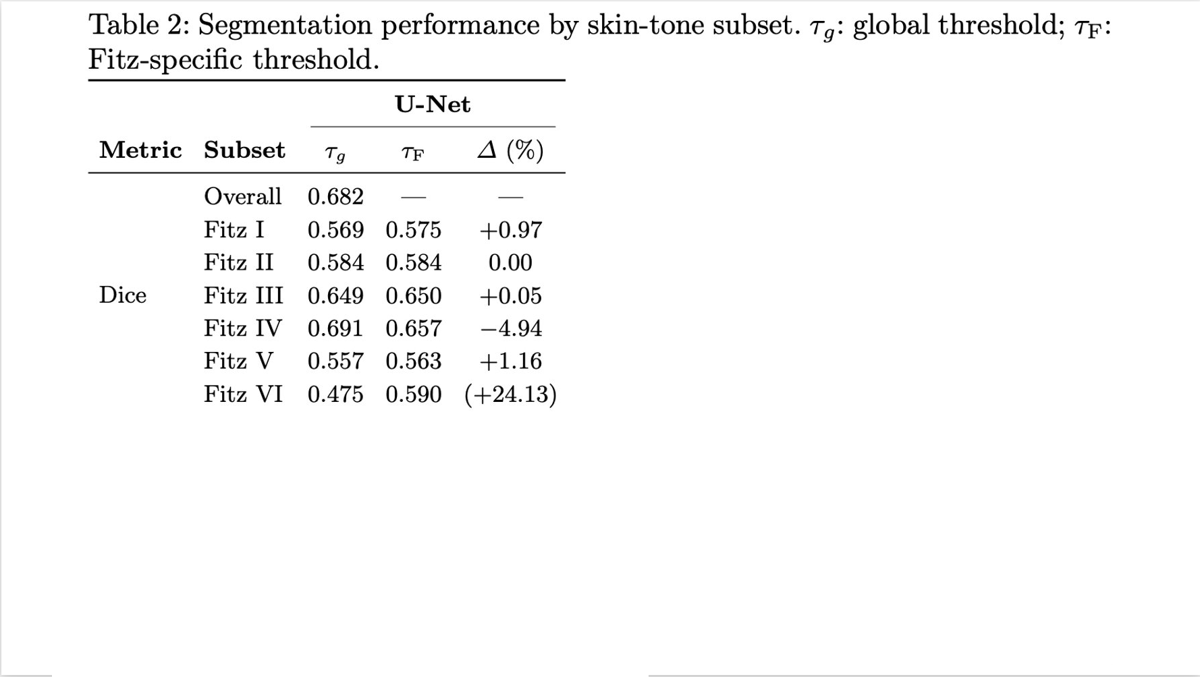
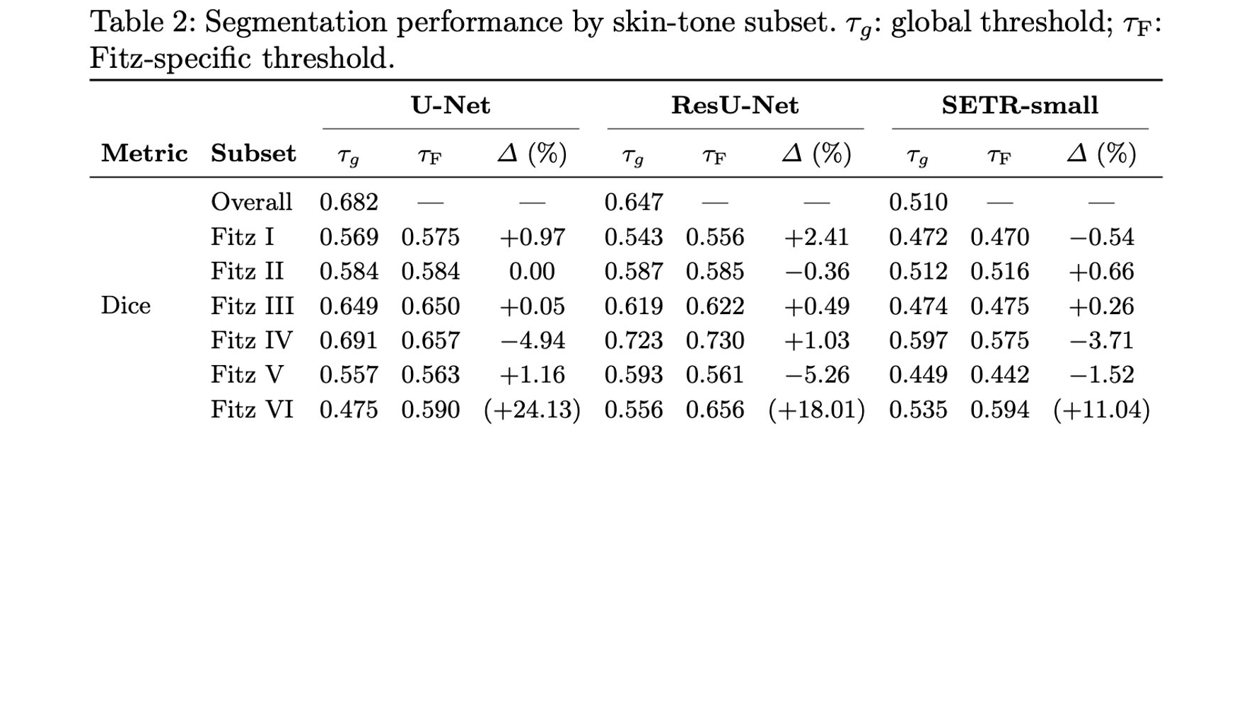
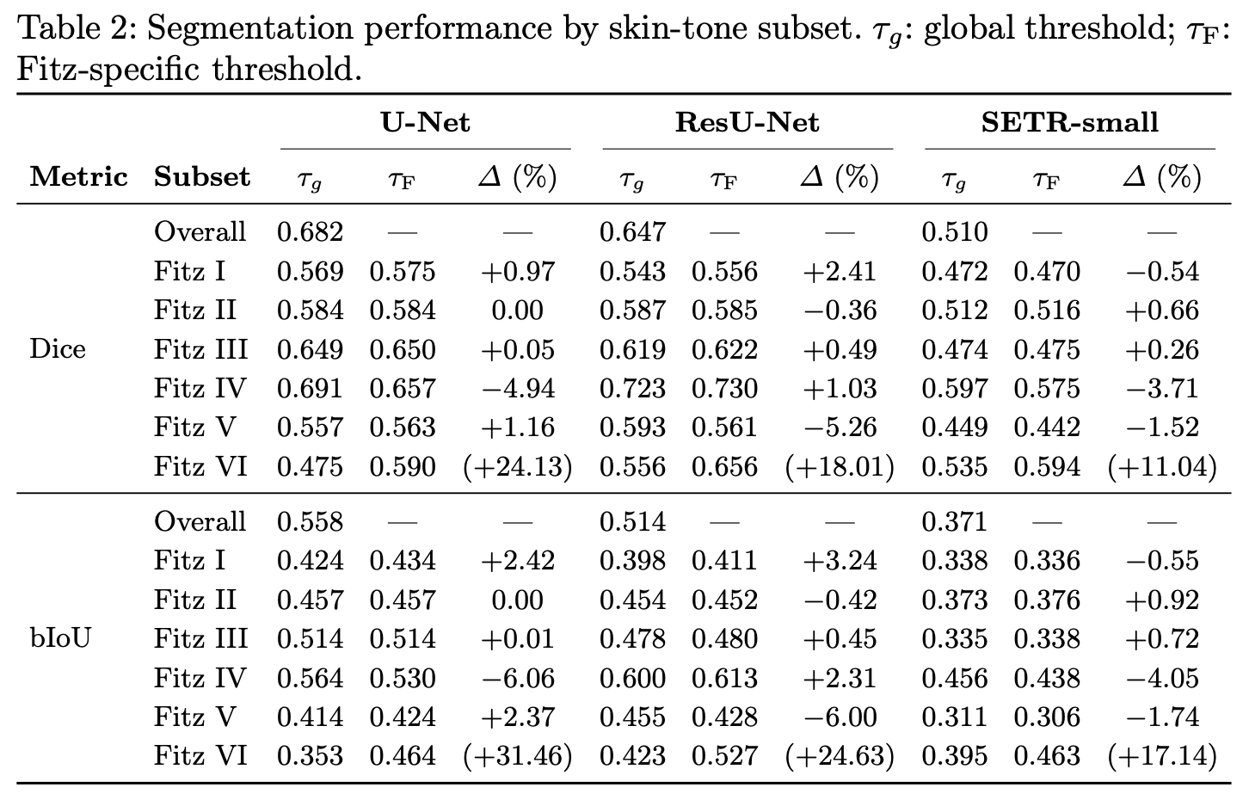
Notes:
Add color highlight to what audience needs to see

Slide 13
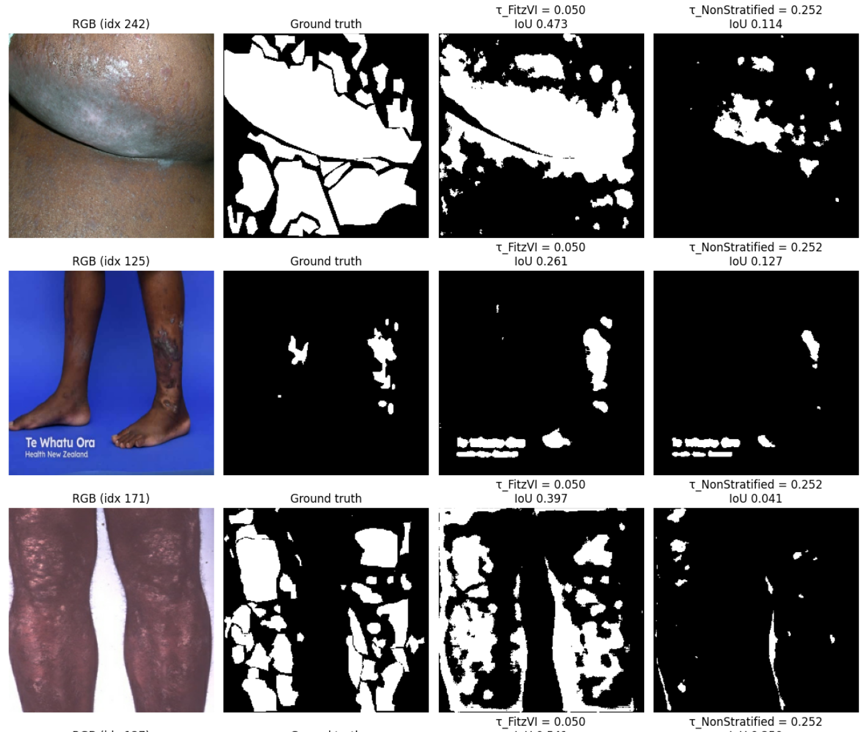
With Fitz-6 Threshold
With overall Threshold
Fitzpatrick thresholding could be a valuable addition to the fairness toolbox for segmentation use cases, but it still has its place in the pecking order
More real data & gold-standard labels
Synthetic data & data augmentation
Transfer learning from other uses, especially cases where the rare subgroup may be less rare
Fitz-aware loss functions, Fitz-aware optimization schemes (as long as aggregate performance doesn't decrease)
(somewhere around here is where Fitz-specific operating points could be introduced)

Slide 14



Future directions
Scaling Fairness-aware Reinforcement Learning with Med-Gemma-27B
Enabled by new cluster (TACC Vista) with 600 Nvidia H200 NVL, NVSwitch, 400 Gbps InfiniBand backbone, etc.
Submitting to the coming ICLR main track, please reach out for collaboration opportunities
Increasing Dataset size
Private clinical data from community care
SCIN dataset
Contains some psoriasis images
SD128 / SD 198 / SD 260
Also contains some psoriasis images
Clinical deployment via mobile app
Notes:
Speed through future directions, make sure t rehease not waffle for too long

Slide 15



Acknowledgments & Contact Details
Mia Markey, PhD
Sophia Xu, MS2
Carlie Reeves, MD
Texas Advanced Computing Cluster, University of Texas at Austin
Google Cloud Platform
Lia Gracey
lia.gracey@austin.utexas.edu
Duncan Stothers
duncanstothers@alumni.harvard.edu
Notes:
QR code

